Slide 1

LIBRARY MANAGEMENT SYSTEM

Slide 2
INTRODUCTION
The Library Management System is a web-based application designed to manage the day-to-day activities of a library.
Developed using Java, JSP (JavaServer Pages), and MongoDB for data storage.
Provides functionalities for both admin and user roles to ensure smooth operations like:
Book management
Author and category handling
Book borrowing and returning
Aims to digitize traditional library processes to reduce manual work and errors.

Slide 3
TECHNOLOGY STACK
Frontend: HTML, CSS, Bootstrap, JavaScript
Backend: Java, JSP
Database: MongoDB
Server: Apache Tomcat
Tools: Eclipse IDE, MongoDB Compass

Slide 4
BACKEND ARCHITECTURE
Built using Java and JSP for core business logic and dynamic page rendering.
MongoDB used as the primary database for storing user and book data.
JDBC is used to establish database connectivity.
Apache Tomcat acts as the web server to deploy and run the application.
JavaBeans manage reusable backend components like user sessions and data operations.

Slide 5
API DEVELOPMENT & ENDPOINTS
Core Endpoints:
User Management:
Register, login, and get user details
Book Management:
Add, update, retrieve, and delete books
Borrowing System:
Borrow and return books
Technology:
REST API architecture with HTTP methods (GET, POST, PUT, DELETE)
Interaction with MongoDB for data persistence

Slide 6
DATABASE DESIGN
Database: MongoDB is used to store data.
Key Collections:
Users: Stores user details (name, email, borrowed books).
Books: Stores book details (title, author, category, availability).
Authors: Stores author information (name, bio, books).
Borrowed Books: Tracks borrowed books (user ID, book ID, return date).
Relationships: Users can borrow multiple books; books can have multiple authors.
Schema: Flexible, schema-less design for easy future changes.

Slide 7
DATABASE INTEGRATION WITH JAVA
MongoDB Driver: Java interacts with MongoDB using its official Java driver.
CRUD Operations:
Create: Adding new records to collections (e.g., new users, books).
Read: Fetching data (e.g., getting all books, searching users).
Update: Modifying existing records (e.g., updating user info, book status).
Delete: Removing records from collections (e.g., deleting a book).
Data Mapping: Java Beans store and retrieve data from the database.
Error Handling: Exceptions are managed for database operations.

Slide 8
AUTHENTICATION & SECURITY
Login & Authentication:
User credentials are verified against MongoDB during login.
Session management or token-based (e.g., JWT) handling ensures secure user actions after login.
Authorization:
Role-based access control restricts access to specific features based on user roles
Admin Role:
Can Add/Edit/Delete Books: Admin can access endpoints like /addBook, /editBook, and /deleteBook to manage the book catalog.
Can Manage Users: Admin can access /manageUsers to view and modify user roles.
User Role:
Can Borrow/Return Books: A user can access /borrowBook and /returnBook but cannot modify the book catalog.

Slide 9
PERFORMANCE OPTIMIZATION
Database Query Optimization: Used efficient queries for category and author data retrieval in MongoDB.
Indexing: Ensured MongoDB collections, like categories, are indexed for faster search and delete operations.
Caching: Implemented session-based messages for success/error notifications to avoid repeated database queries.
Frontend Optimization: Leveraged Bootstrap and DataTables for responsive and fast-loading tables.

Slide 10
FRONTEND-BACKEND INTEGRATION
JSP-Based Approach (MVC Pattern)
JSP Pages (e.g., manage-categories.jsp, add-category.jsp) dynamically render the user interface based on data fetched from the database.
Controller Logic (within JSP) manages requests, processes data (e.g., adding/deleting categories), and redirects accordingly.
Session Management ensures secure access by validating login credentials before performing any actions like adding or deleting categories.

Slide 11
DEPLOYMENT & TESTING
Deployment:
Hosted on Apache Tomcat server.
MongoDB used for data storage.
Testing:
Unit Testing: Validates backend functions (e.g., category deletion).
Integration Testing: Ensures frontend-backend interaction.

Slide 12
FUTURE IMPROVEMENTS
User Role Management: Implement advanced role-based access control.
Enhanced Search: Improve book and category search functionality.
Mobile App: Develop a mobile app for easier library access.
User Analytics: Add analytics for user activity and book trends.

Slide 13
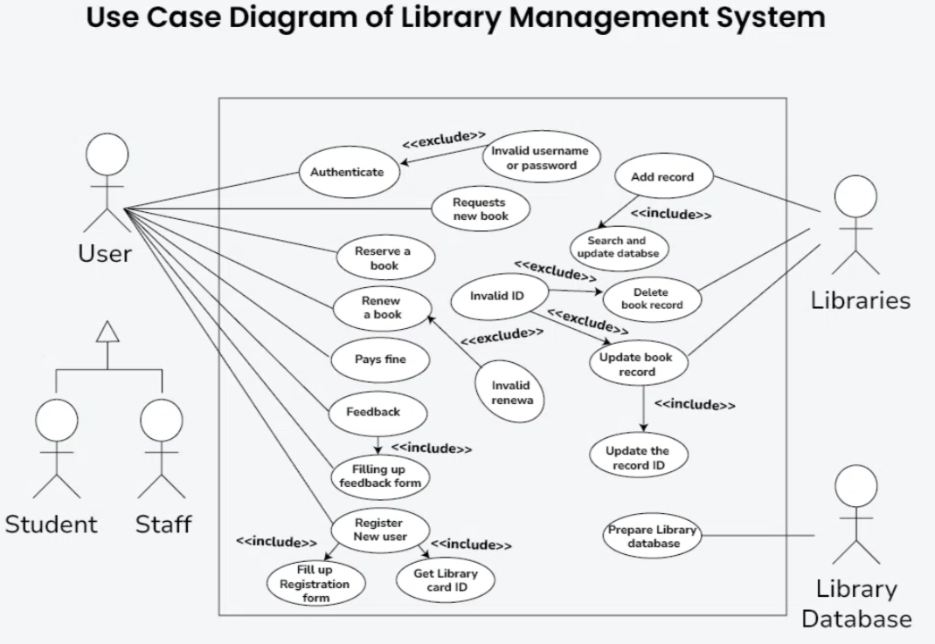

Slide 14
TEAM ROLES & RESPONSIBILITIES
Team Leader:
2310030411-manage the project timeline and assign tasks.
Backend Developer:
129,247,125:Will develop the core logic using Java.
Frontend Developer:
411,124Will design the UI and connect it to the backend.
Tester & Debugger:
125: Will test the system and fix errors.

Slide 15
CONCLUSION
The Library Management System is a robust and efficient web-based application developed using Java, JSP, and MongoDB. It provides a user-friendly interface for administrators to manage books, authors, and categories, while users can borrow and return books seamlessly. The system enhances the traditional library workflow by offering digital access, streamlined operations, and real-time updates.

Slide 16
THANK YOU

